Slide 1
Number Systems

Slide 2
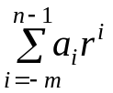
Number Systems (1)
Positional Notation
N = (a_{n-1}a_{n-2} ... a₁a₀ . a₋₁a₋₂ ... a_{-m})_{r} (1.1)
where . = radix point
r = radix or base
n = number of integer digits to the left of the radix point
m = number of fractional digits to the right of the radix point
a_{n-1} = most significant digit (MSD)
a_{-m} = least significant digit (LSD)
Polynomial Notation (Series Representation)
N = a_{n-1} x r^{n-1} + a_{n-2} x r^{n-2} + ... + a₀ x r⁰ + a₋₁ x r⁻¹ ... + a_{-m} x r^{-m}
= (1.2)
N = (251.41)₁₀ = 2 x 10² + 5 x 10¹ + 1 x 10⁰ + 4 x 10⁻¹ + 1 x 10⁻²

Slide 3
Number Systems (2)
Binary numbers
  Digits = {0, 1}
  (11010.11)₂ = 1 x 2⁴ + 1 x 2³ + 0 x 2² + 1 x 2¹ + 0 x 2⁰ + 1 x 2⁻¹ + 1 x 2⁻²
  = (26.75)₁₀
  1 K (kilo) = 2¹⁰ = 1,024, 1M (mega) = 2²⁰ = 1,048,576,
1G (giga) = 2³⁰ = 1,073,741,824
Octal numbers
  Digits = {0, 1, 2, 3, 4, 5, 6, 7}
  (127.4)₈ = 1 x 8² + 2 x 8¹ + 7 x 8⁰ + 4 x 8⁻¹ = (87.5)₁₀
Hexadecimal numbers
  Digits = {0, 1, 2, 3, 4, 5, 6, 7, 8, 9, A, B, C, D, E, F}
  (B65F)₁₆ = 11 x 16³ + 6 x 16² + 5 x 16¹ + 15 x 16⁰ = (46,687)₁₀

Slide 4
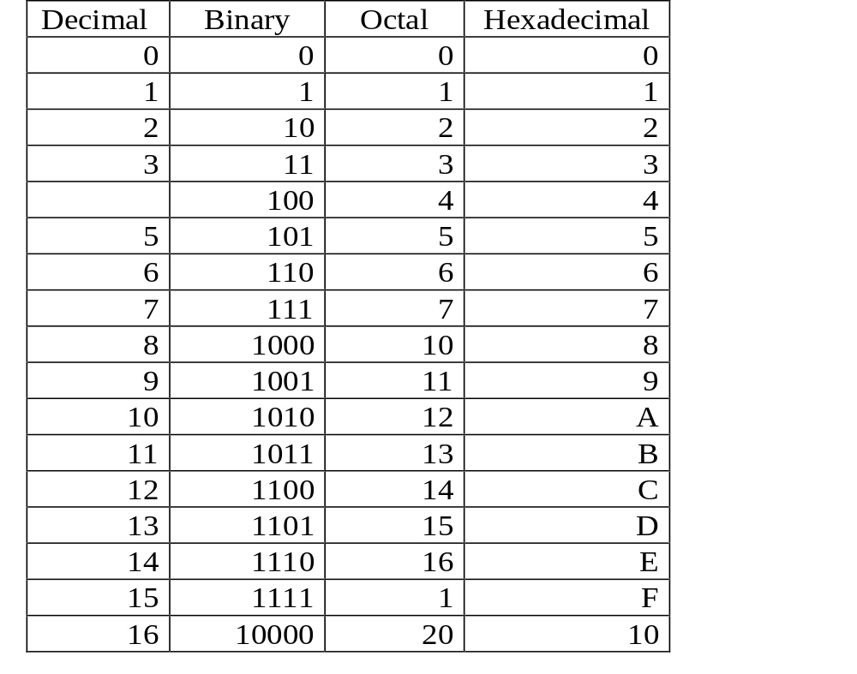
Number Systems (3)
Important Number Systems (Table 1.1)

Slide 5
Base Conversion (1)
Series Substitution Method
  Expanded polynomial form of representation:
  N = a_{n-1}r^{n-1} + … + a₀r⁰ + a₋₁r⁻¹ + … + a_{-m}r^{-m} (1.3)
  Examples:
    (11010)₂ →( ? )₁₀
    N = 1×2⁴ + 1×2³ + 0×2² + 1×2¹ + 0×2⁰
    = (16)₁₀ + (8)₁₀ + 0 + (2)₁₀ + 0
    = (26)₁₀
    (627)₈ → ( ? )₁₀
    N = 6×8² + 2×8¹ + 7×8⁰
    = (384)₁₀ + (16)₁₀ + (7)₁₀
    = (407)₁₀

Slide 6
Base Conversion (2)
Radix Divide Method
  Used to convert the integer in base 10 to the equivalent base B integer.

Slide 7
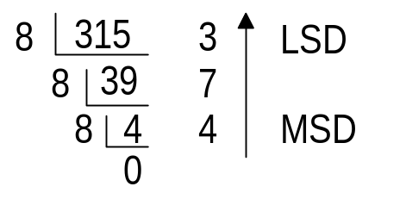
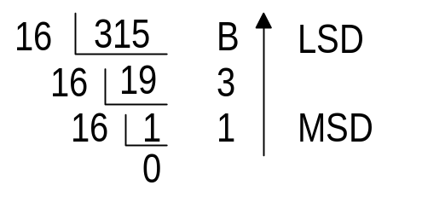
Base Conversion (3)
  Examples
    (315)₁₀ = (473)₈
    (315)₁₀ = (13B)₁₆

Slide 8
Base Conversion (4)
Radix Multiply Method
  Used to convert the fraction in base 10 to the equivalent base B fraction.

Slide 9
Base Conversion (5)
  Examples
    (0.479)₁₀ = (0.3651…)₈
    MSD 3.832 ← 0.479 × 8
    6.656 ← 0.832 × 8
    5.248 ← 0.656 × 8
    LSD 1.984 ← 0.248 × 8
    …
    (0.479)₁₀ = (0.0111…)₂
    MSD 0.9580 ← 0.479 × 2
    1.9160 ← 0.9580 × 2
    1.8320 ← 0.9160 × 2
    LSD 1.6640 ← 0.8320 × 2
    …

Slide 10
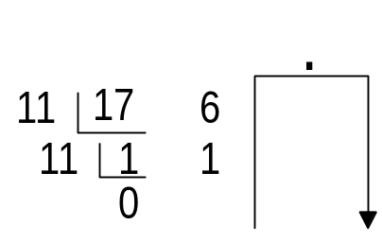
Base Conversion (6)
Example
  (18.6)₉ = ( ? )₁₁
  (a) Convert to base 10 using series substitution method:
  N₁₀ = 1 × 9¹ + 8 × 9⁰ + 6 × 9⁻¹
  = 9 + 8 + 0.666…
  = (17.666…)₁₀
  (b) Convert from base 10 to base 11 using radix divide and multiply
  method:
  7.326 ← 0.666 × 11
  3.586 ← 0.326 × 11
  6.446 ← 0.586 × 11
  N₁₁ = (16.736 …)₁₁

Slide 11
Base Conversion (7)
Examples
  (001 010 111. 100)₂ = (127.4)₈ (group bits by 3)
  (1011 0110 0101 1111)₂ = (B65F)₁₆ (group bits by 4)

